Slide 1

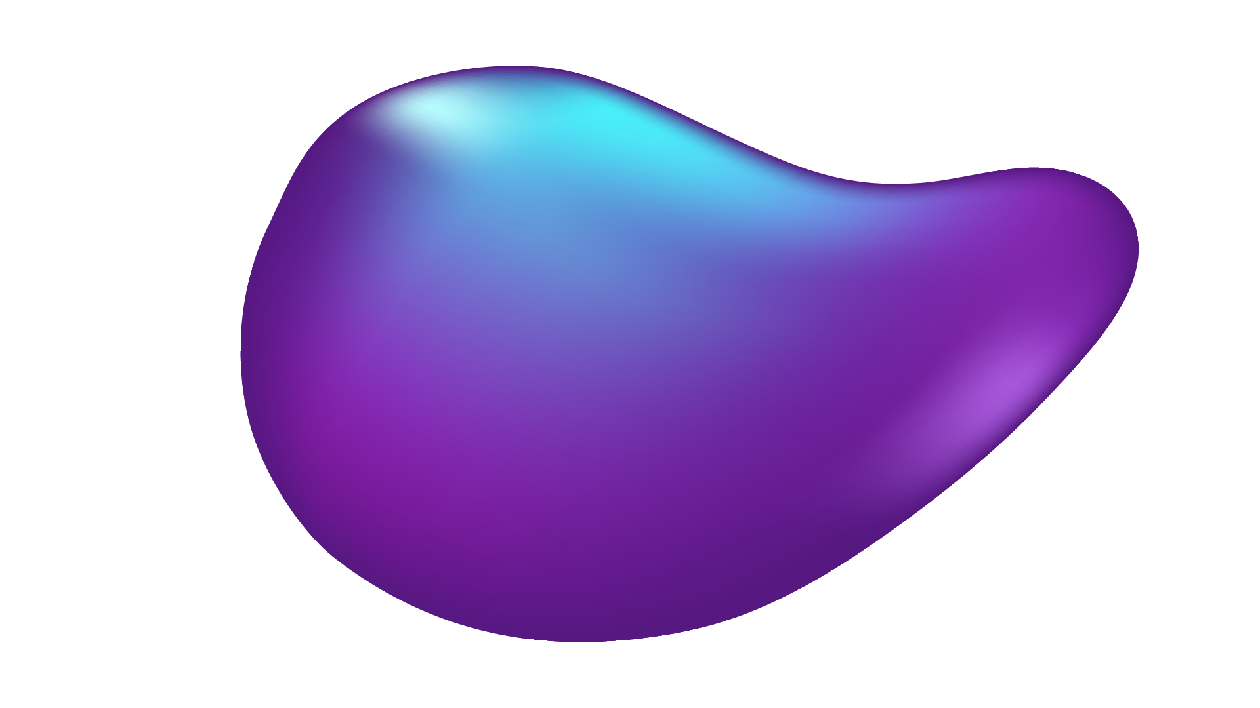
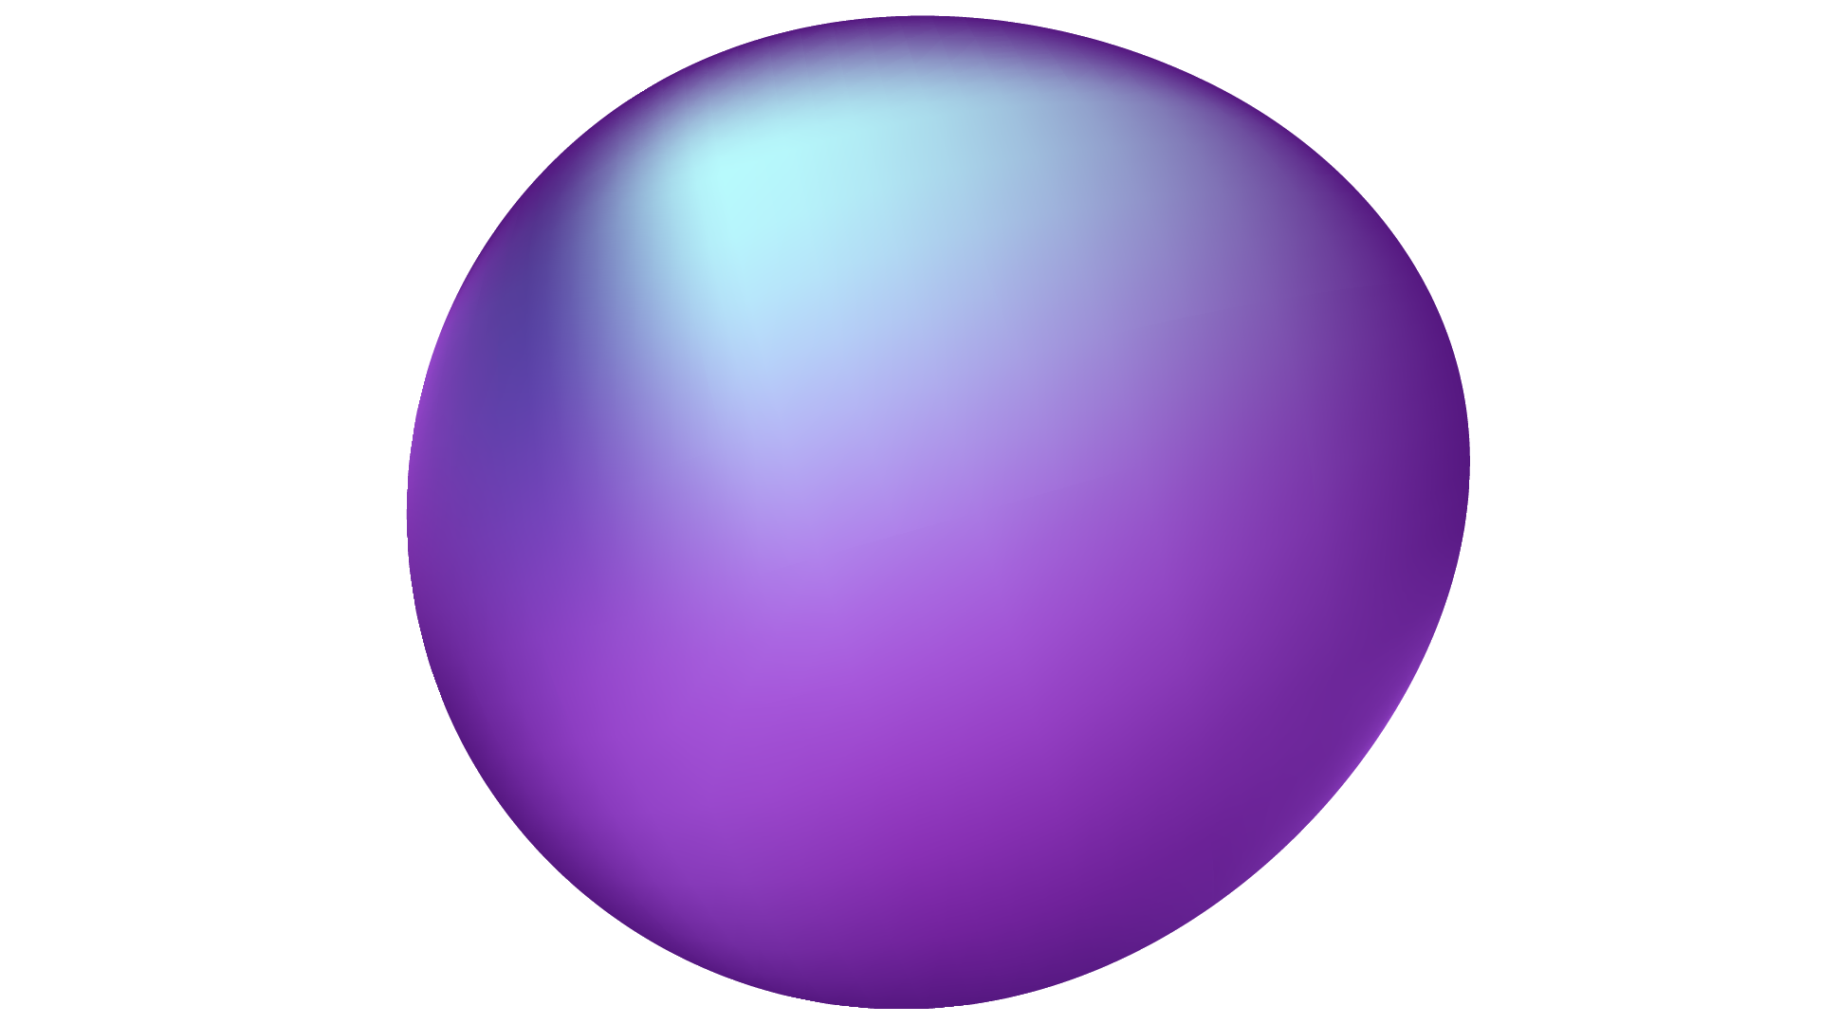
PROTOTYPE POLLUTION
Adduci Salvatore - 247514 Cirimele Davide - 247438
Sestito Pierpaolo - 242707
Tripodi Gabriel - 242784
Ullah Kaleem - 241085

Slide 2
WHAT IS PROTOTYPE POLLUTION?
It is a Javascript vulnerability that enables an attacker to add arbitrary properties to global object prototypes, which may be inherited by user-defined objects.
It lets an attacker control properties of objects that would otherwise be inaccessible.
IT’S NOT A STANDALONE VULNERABILITY, THIS CAN BE POTENTIALLY BE CHAINED WITH OTHER VULNERABILITIES!

Slide 3
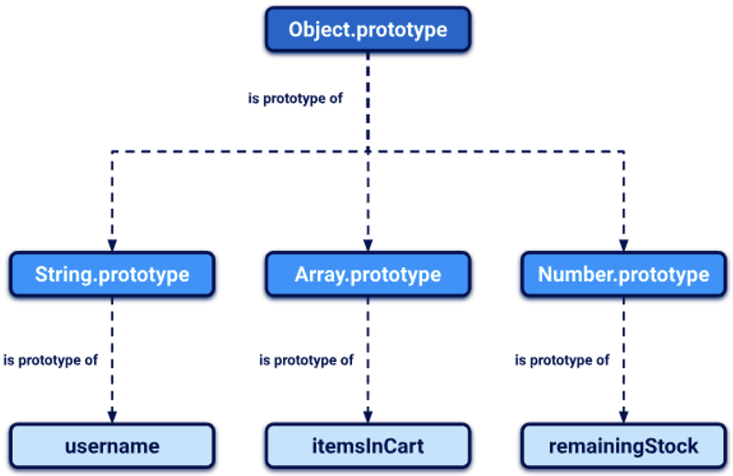
JAVASCRIPT PROTOTYPES AND INHERITANCE
JAVASCRIPT WORKS DIFFERENT !!!
Objects inherits from other objects through what is called the Prototype Chain
Each object has a prototype (and is linked to it).
When you look for a property in an object, JavaScript looks first at the definition of the object itself, then at its prototype, and so on, until it reaches the Object.prototype base object.

Slide 4
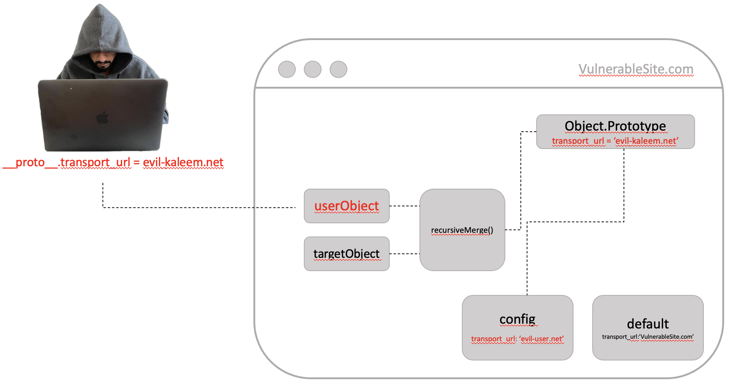
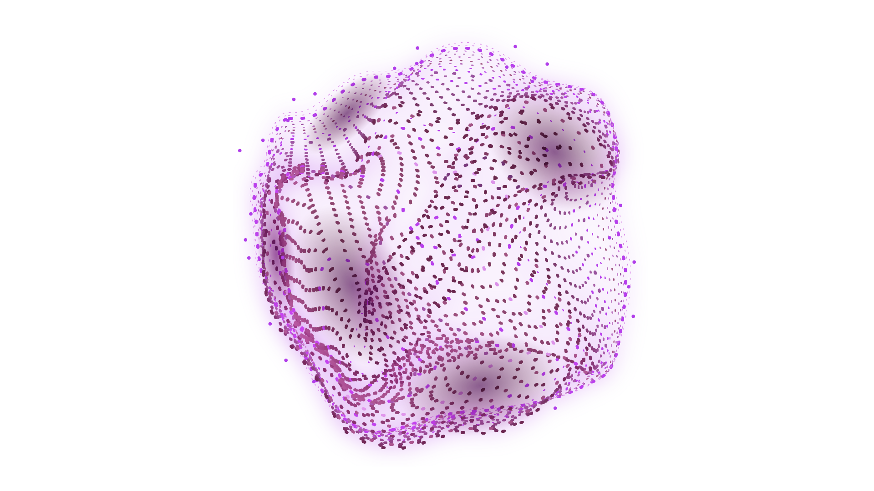
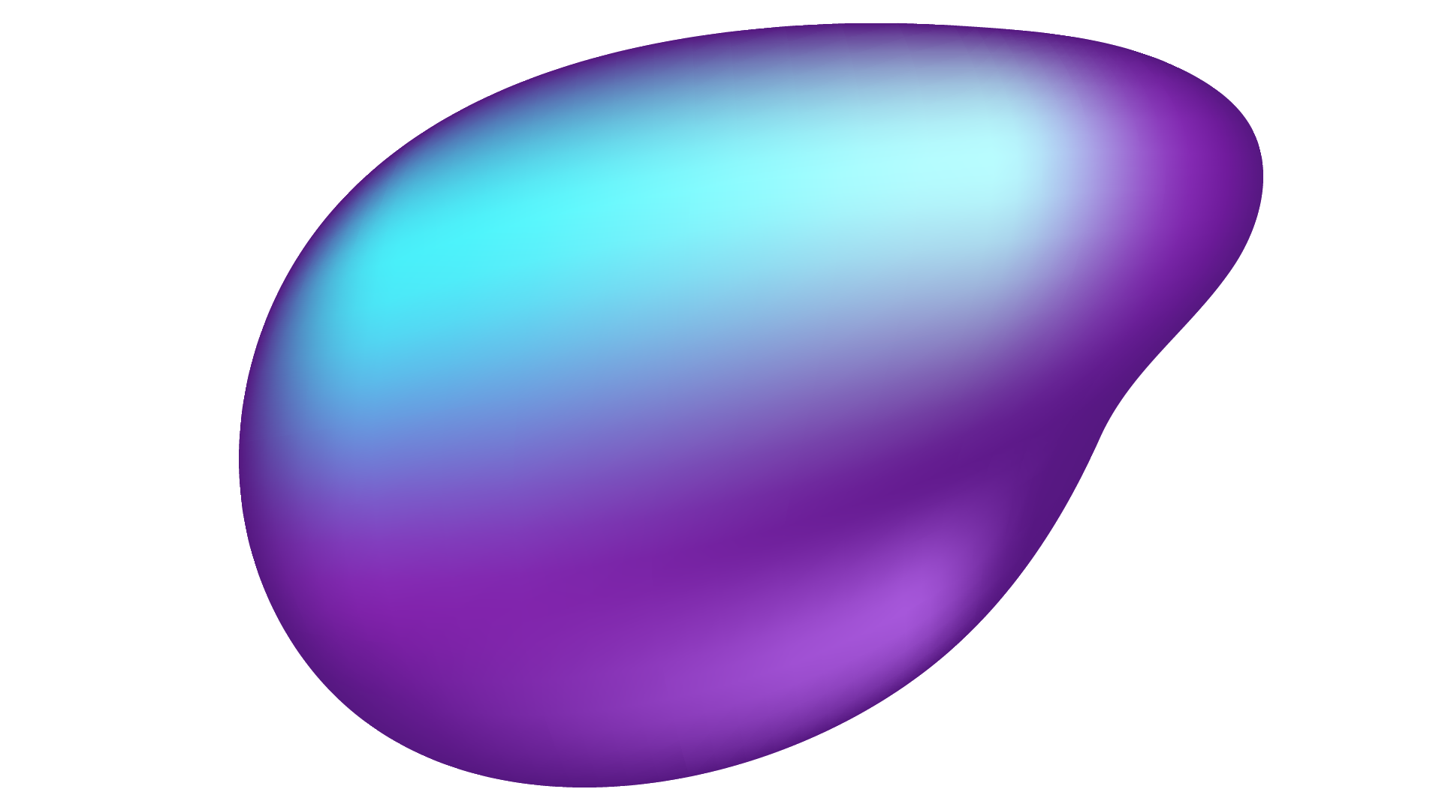

Slide 5
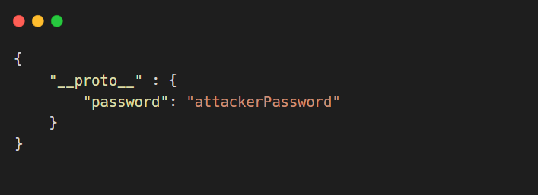
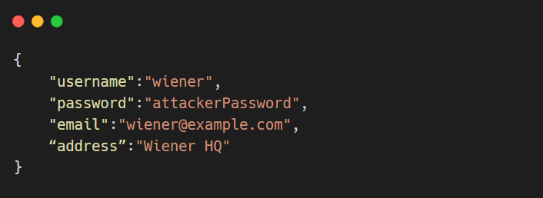
WHY IT WORKS?
Prototype pollution arise when a JavaScript function recursively merges an object containing user-controllable properties (userObject) into an existing object (targetObject), without first sanitizing the keys.
RecursiveMerge(userObject, targetObject)
targetObject.__proto__.password = “attackerPassword”
userObject
Result
targetObject after the RecursiveMerge

Slide 6
WHY IT WORKS?
Allow the attacker to inject a property with a key like __proto__
The merge operation may assign the nested properties to the object’s prototype instead of the target itself.
RESULT: the attacker pollute the prototype with properties, which may be used by the application in a dangerous way
It’s possible to pollute any prototype object, the most commonly occurs with the Object.prototype (built-in global).

Slide 7
MAIN COMPONENTS EXPLOITATION
1
2
3
SINK
EXPLOITABLE GADGET
PROTOTYPE POLLUTION SOURCE

Slide 8

PROTOTYPE POLLUTION SOURCE
It is any user-controllable input that enables you to add arbitrary properties to prototype objects.
The most common:
The URL (query or fragment string - hash)
JSON-based input
Web Messages

Slide 9
Prototype pollution via the URL
Consider the following URL constructed by an attacker:
https://vulnerable-website.com/?__proto__[evilProperty]=payload
It will result in:
targetObject.__proto__.evilProperty = 'payload';
During this assignment, the JS engine treats __proto__ as a getter for the prototype.

Slide 10
Prototype pollution via the URL
WHAT CAN BE A BIG PROBLEM?
Assuming that the target object uses the default Object.prototype, all objects in the runtime will now inherit evilProperty.
Usually an attacker try to pollute the prototype with properties that are used by the application, or any imported libraries.

Slide 11
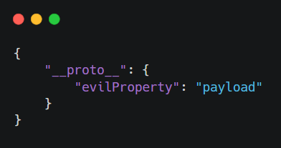
Prototype pollution via
JSON Input
Let's say an attacker injects the following malicious JSON, for example, via a web message:

Slide 12
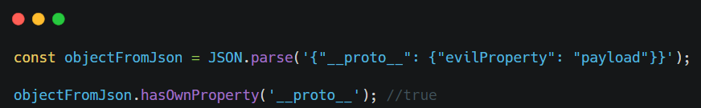
Prototype pollution via
JSON Input
If the object is parsed with JSON.parse() method it will have a new property with key __proto__.
This method treats any key in JSON object as an arbitrary string.

Slide 13
SINK
It is a JS function or DOM element, which enables you to execute arbitrary JS code or system commands, if you can access them via prototype pollution.

Slide 14
EXPLOITABLE GADGET
It is any property that is passed into a sink without proper filtering or sanitization.
This is any property that is:
Used by the application in an unsafe way
Attacker-controllable via prototype pollution.

Slide 15
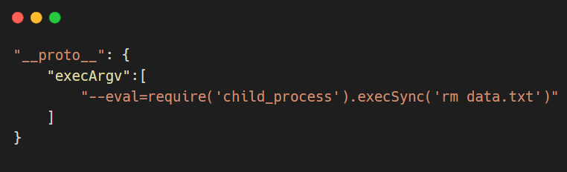
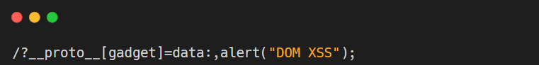
CLIENT VS SERVER
Prototype Pollution commonly leads to:
CLIENT
SERVER
DOM-based cross-site scripting
Remote Code Execution

Slide 16
CLIENT

Slide 17
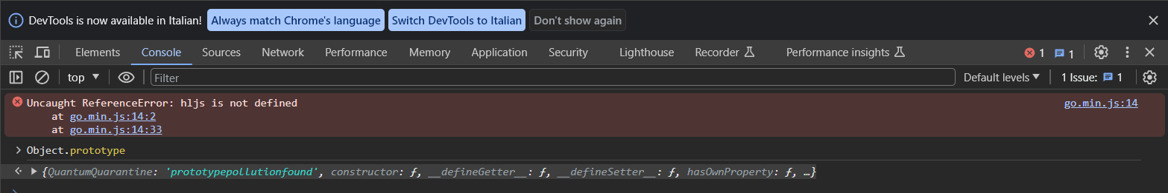
FINDING PROTOTYPE POLLUTION SOURCES MANUALLY
You need to try different ways of adding an arbitrary property to Object.prototype until you find a source that works.
It involves the following high-level steps:
Try injection via the query string, URL fragment, and any JSON input.
If you check on your browser console, inspect Object.prototype to see if you have successfully polluted it:

Slide 18
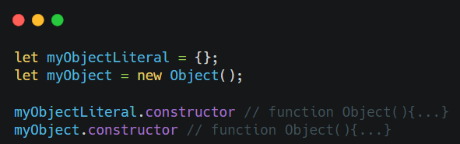
PROTOTYPE POLLUTION VIA THE CONSTRUCTOR
In some cases we have to challenge with some defenses like the stripping of any properties with the key __proto__ before merging them.
Every JavaScript object has a constructor property, which contains a reference to the constructor function that was used to create it.
As myObject.constructor.prototype is equivalent to myObject.__proto__, this provides an alternative vector for prototype pollution.

Slide 19
SERVER

Slide 20
SERVER-SIDE PROTOTYPE POLLUTION
Server-side prototype pollution is generally more difficult to detect than its client-side variant, for several reason:
No source code access
Lack of developer tools
The DoS problem
Pollution persistence

Slide 21
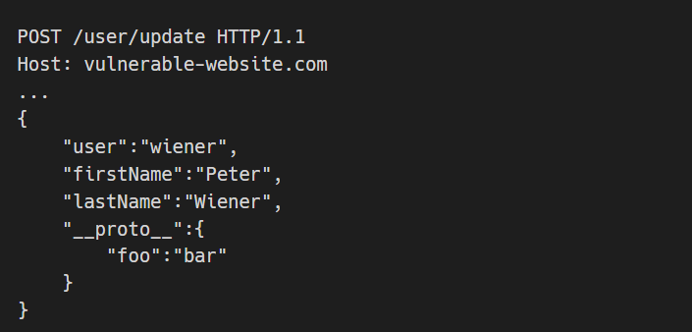
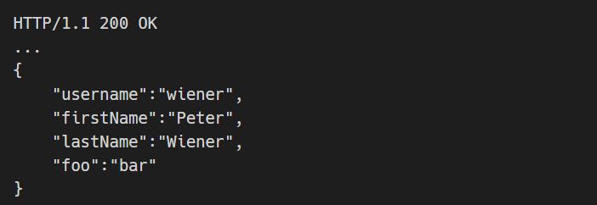
Detecting prototype pollution via polluted property reflection
Usually when we do a POST or PUT requests that submit JSON data to an application or API, the server responds with a JSON that represents the new or updated object.

Slide 22
Detecting prototype pollution without polluted property reflection
We can try to override:
Status code
JSON spaces
Charset
These injections produce a consistent and distinctive change in server behaviour when successful.

Slide 23
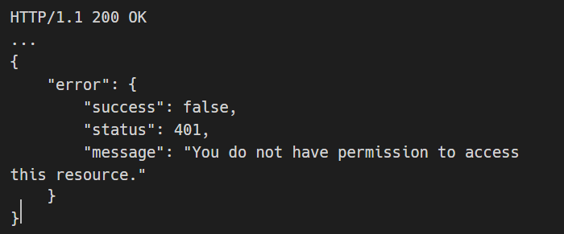
Status code override
Some server-side frameworks when there is an error, send a 200 OK response and include an error object in the body with a different status.
You can try to polluting the prototype with your own status property.
"__proto__":{"status":555}

Slide 24
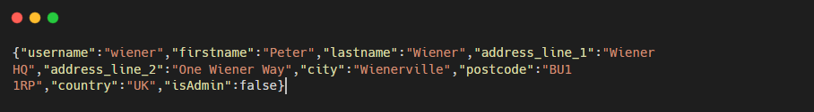
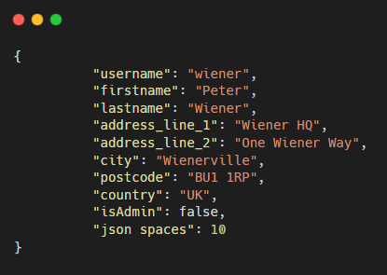
JSON spaces override
Express framework provides an option called json spaces.
It defines the number of spaces to indent any JSON data in response.
You can try to polluting the prototype with your json spaces property
"__proto__":{"json spaces":10}

Slide 25
Charset override
If character encoding is defined, we can try to pollute the content-type header attribute. For example injecting UTF-7 (usually is used UTF-8).
Example
Try to pollute the prototype with a content-type property that specifies UTF-7 charset:
Add an arbitrary UTF-7 encoded string to a property that's reflected in a response:
If you successfully polluted the prototype, the UTF-7 string should be decoded in the response:

Slide 26
Remote Code Execution via prototype pollution
Server-side prototype pollution can potentially result in RCE.
There are several command-execution sinks in Node. Many of these occur in child_process model:
fork()
execSync()
Both of them enable to create new subprocesses.

Slide 27
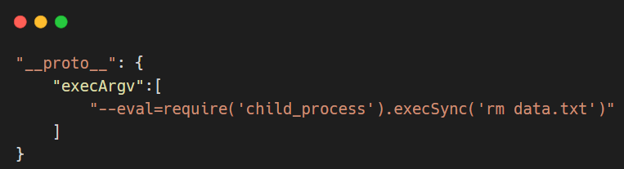
Remote Code Execution via fork()
The fork() method accepts an object called execArgv.
This is an array of string containing command-line arguments that will be used when a child process is spawned.
Potential gadget: If this option is left undefined by the devs this can be manipulated via prototype pollution in a malicious way.

Slide 28

Remote Code Execution via execSync()
Similar to fork() but it doesn’t accept execArgv property.
You can still try to inject system commands.
HOW? Simultaneously polluting both shell and input options.
If these are not defined can result in potential gadgets for prototype pollution.
The shell option only accepts the name of the shell’s executable
Always executed with the -c flag → most shells use it to let you pass in a command as string.
The input option contains the payload passed via stdin to the shell’s executable.
Try to use vim as a shell. If it is installed on the server, although it isn’t really intended to be a shell, this can create a potential vector for RCE:
“shell”:“vim”,
“input”:”:“! <command>\n”

Slide 29
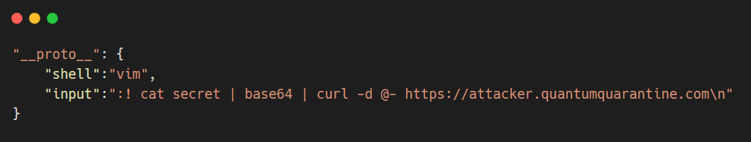
Remote Code Execution via execSync()

Slide 30
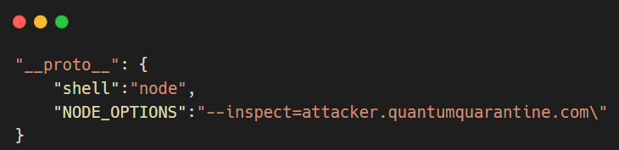
RCE: Other gadget in addition to execArgv, shell, input
The NODE_OPTIONS is another potential gadget that could allow you to pollute the prototype.
It is an environment variable that enables you to define a string containing command-line args. This args are used by default whenever you start a new Node process.
If it is undefined, you can potentially control via prototype pollution.

Slide 31
Bypassing input filters for prototype pollution
Sometimes websites attempt to prevent prototype pollution sanitizing keys before merging them. If the property was not added, try different techniques, such as:
Or try via the constructor
Finding prototype pollution sources manually can be a fairly tedious process. It can be automatize with some tools.

Slide 32
PREVENTION
SANITIZING PROPERTY KEYS
PREVENTING CHANGES TO THE PROTOTYPE OBJECTS
Using an allowlist of permitted keys
Using Object.freeze()
USING SAFER ALTERNATIVES
PREVENTING AN OBJECT FROM INHERITING PROPERTIES
Like Map (with method get()) or Set (with method has())
Using Object.create()

Slide 33
Client-side prototype pollution via flawed sanitization
Try polluting Object.prototype by injecting an arbitrary property via URL query string.
/?__proto__.QuantumQuarantine=polluted
/?__proto__[QuantumQuarantine]=polluted or via constructor.
Open the DevTools panel and check through Console tab entering “Object.prototype”
We can notice that the injected QuantumQuarantine property has not been added.
This is because in the JavaScript files, loaded by the target site, there’s a file called deparamSanitized.js that sanitizes key.
It strips potentially dangerous property keys but it does not apply this filter recursively.
In searchLogger.js we identify a potential gadget called transport_url.
If it is present a script is dynamically appended to the DOM.
With our script we try to pre_append __pro and post-append to__ to the key “__proto__” in order to try __pro__proto__to__
PLEASE NOTE: We know that is necessarily only one time, but imagine a case that the sanitization is done n times.
The malicious payload is /?__pro__proto__to__[transport_url]=data:,alert(1);

Slide 34
Privilege escalation via server-side prototype pollution
Compile the form with your data and enable the “Intercept” action in OWASP-ZAP.
Submit the form and notice that you intercept a POST request to /my-account/change-address and it contains the form data in JSON format
With Open/Resend Request Editor we can manipulate the request adding a new arbitrary property with the key __proto__
"__proto__": {"QuantumQuarantine":"polluted"}
The object in the response now includes the arbitrary property that we injected.
In the response body the isAdmin property is currently set to false.
We modify the request to try polluting the prototype with our own isAdmin property:
"__proto__": {"isAdmin":true}
The isAdmin value in the response has been updated. Refresh the page, now we have a link to access the admin panel and we can delete carlos.
Our script solve this labs using Selenium and repeating all the steps.

Slide 35
Bypassing flawed input filters for server-side prototype pollution
STEPS 1,2 in the lab before.
But now we notice that our arbitrary property is not added. This is due to some sanitization process done in the server-side.
Using again the Open/Resend Request Editor of OWASP ZAP we can try to inject using constructor key:
We can try to override the json spaces value and check if the indentation in the response will change.
"constructor": { "prototype": { "json spaces":10 } }
Notice that the JSON indentation has increased based on the value of your injected property.
This strongly suggests that you have successfully polluted the prototype.
Try polluting the prototype with your own isAdmin property:
"constructor": { "prototype": { "isAdmin":true } }
The isAdmin value in the response has been updated. Refresh the page, now we have a link to access the admin panel and we can delete carlos.
Our script solve this labs using Selenium and repeating all the steps.

Slide 36


THANKS FOR YOUR ATTENTION!
QuantumQuarantine Repository

